Slide 1
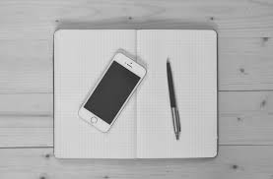
IOS NOTES APPLICATION

Slide 2
Team: Keyboard Warriors
TEAMMATES
Sai Palutla (Developer)
Srinivasa Reddy D (Scrum Master, Developer)
Prashanth Kumar Konduru (Product Owner)
Keyboard Warrior ^{Noun} : A person who equips a tactical keyboard and fights in battlegrounds like Facebook and Twitter.

Slide 3
What are we making?
Notes App for iOS – Similar to the iOS system app but with some additional features.
With the help of our application user can create the notes, edit the notes and able to Scan the physical Document and able to save the notes in their Database.
Using Swift as programming language
User Interface using Storyboards
Notes:
We are making an iOS notes application similar to the system app on iOS with some additional features.
The programming language we are using is Swift
The user interface is being developed using Storyboards on XCode

Slide 4
Method used
Agile – Scrum Methodology
We used Trello to implement the agile board.
User Stories describe the features of the application
In our Project we planned 4 sprint.
Sprint duration ~ 2 weeks
In each sprint process we are adding the new important feature for the application
. Like in the first sprint developing create, delete and edit notes feature in application.
Later on we added face ID features and camera option for the user to Scan the physical documents and for privacy.
Notes:
We plan on developing this app by applying the Scrum method.
We have laid out a few user stories to take into development. More will be added for each sprint if necessary, during the sprint planning meeting.
We are going to have weekly scrum meetings. Sprint duration is approx. 2 weeks.

Slide 5
Project timeline
We have almost hit our project goals.
Our goals are like 80% reached.
We have some of our to be done for next sprint as well.
Notes:
We plan on developing this app by applying the Scrum method.
We have laid out a few user stories to take into development. More will be added for each sprint if necessary, during the sprint planning meeting.
We are going to have weekly scrum meetings. Sprint duration is approx. 2 weeks.

Slide 6
Progress so far since midterm
During the initial presentation, we barely started the development.
Now, we have a minimum viable product.
Most of the user stories were implemented.
Collection of all the requirements that are needed for the application.
Notes:
We plan on developing this app by applying the Scrum method.
We have laid out a few user stories to take into development. More will be added for each sprint if necessary, during the sprint planning meeting.
We are going to have weekly scrum meetings. Sprint duration is approx. 2 weeks.

Slide 7
Progress so far since midterm
Our app is a IOS application.
We need to run our app on iOS devices.
So buy a new phone for this Christmas and install our App.
Notes:
We plan on developing this app by applying the Scrum method.
We have laid out a few user stories to take into development. More will be added for each sprint if necessary, during the sprint planning meeting.
We are going to have weekly scrum meetings. Sprint duration is approx. 2 weeks.

Slide 8
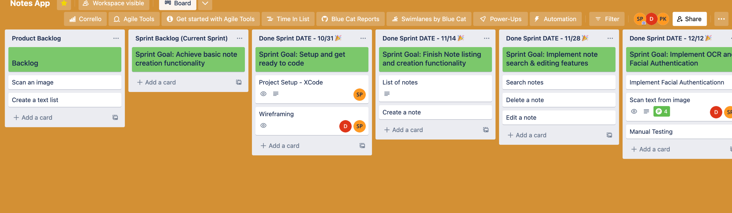
SCRUM BOARD
Notes:
We have chosen trello to create our scrum board.
You can see the product backlog that contains the user stories not in the current and next sprints.
When the sprint finishes, the completed stories are moved to the completed sprint list. If a user story is blocked it is added back to the product backlog and included in the later sprints.

Slide 9
USE CASE Diagram
Notes:
This is the activity diagram for the app. The user can create edit and delete notes. Add and remove text and images.

Slide 10
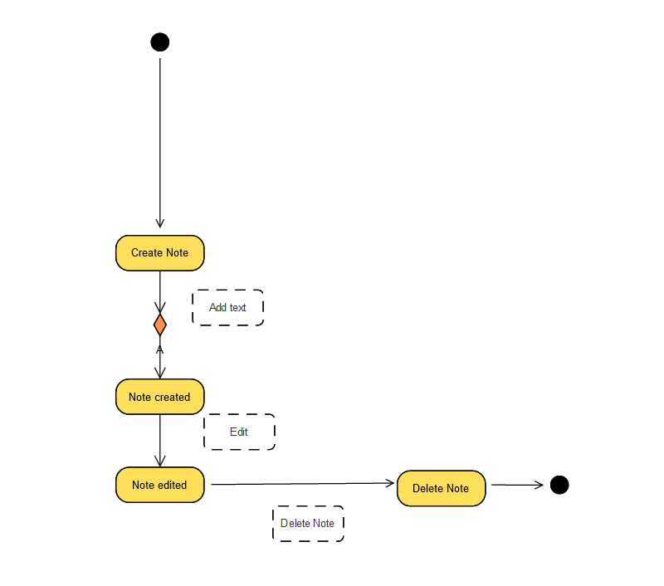
Activity Diagram
Notes:
This is the activity diagram for the app. The user can create edit and delete notes. Add and remove text and images.

Slide 11
Design Patterns
MVC (Model-View-Controller)
Singleton
Notes:
We plan on developing this app by applying the Scrum method.
We have laid out a few user stories to take into development. More will be added for each sprint if necessary, during the sprint planning meeting.
We are going to have weekly scrum meetings. Sprint duration is approx. 2 weeks.

Slide 12
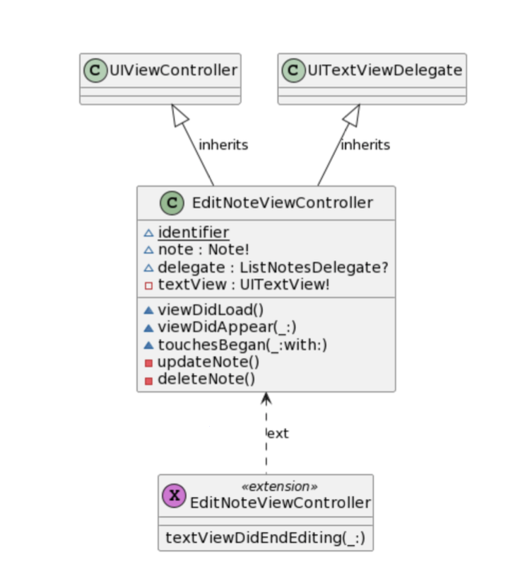
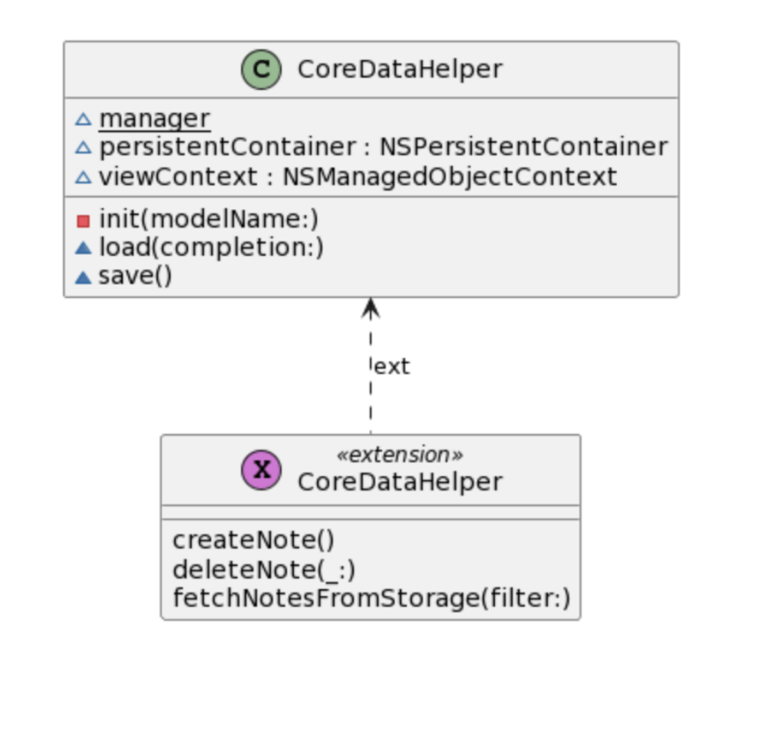
Class Diagram
Notes:
We plan on developing this app by applying the Scrum method.
We have laid out a few user stories to take into development. More will be added for each sprint if necessary, during the sprint planning meeting.
We are going to have weekly scrum meetings. Sprint duration is approx. 2 weeks.

Slide 13
DEMO
Notes:
We plan on developing this app by applying the Scrum method.
We have laid out a few user stories to take into development. More will be added for each sprint if necessary, during the sprint planning meeting.
We are going to have weekly scrum meetings. Sprint duration is approx. 2 weeks.

Slide 14
THANK YOU

